Slide 1
RT analysis

Slide 2
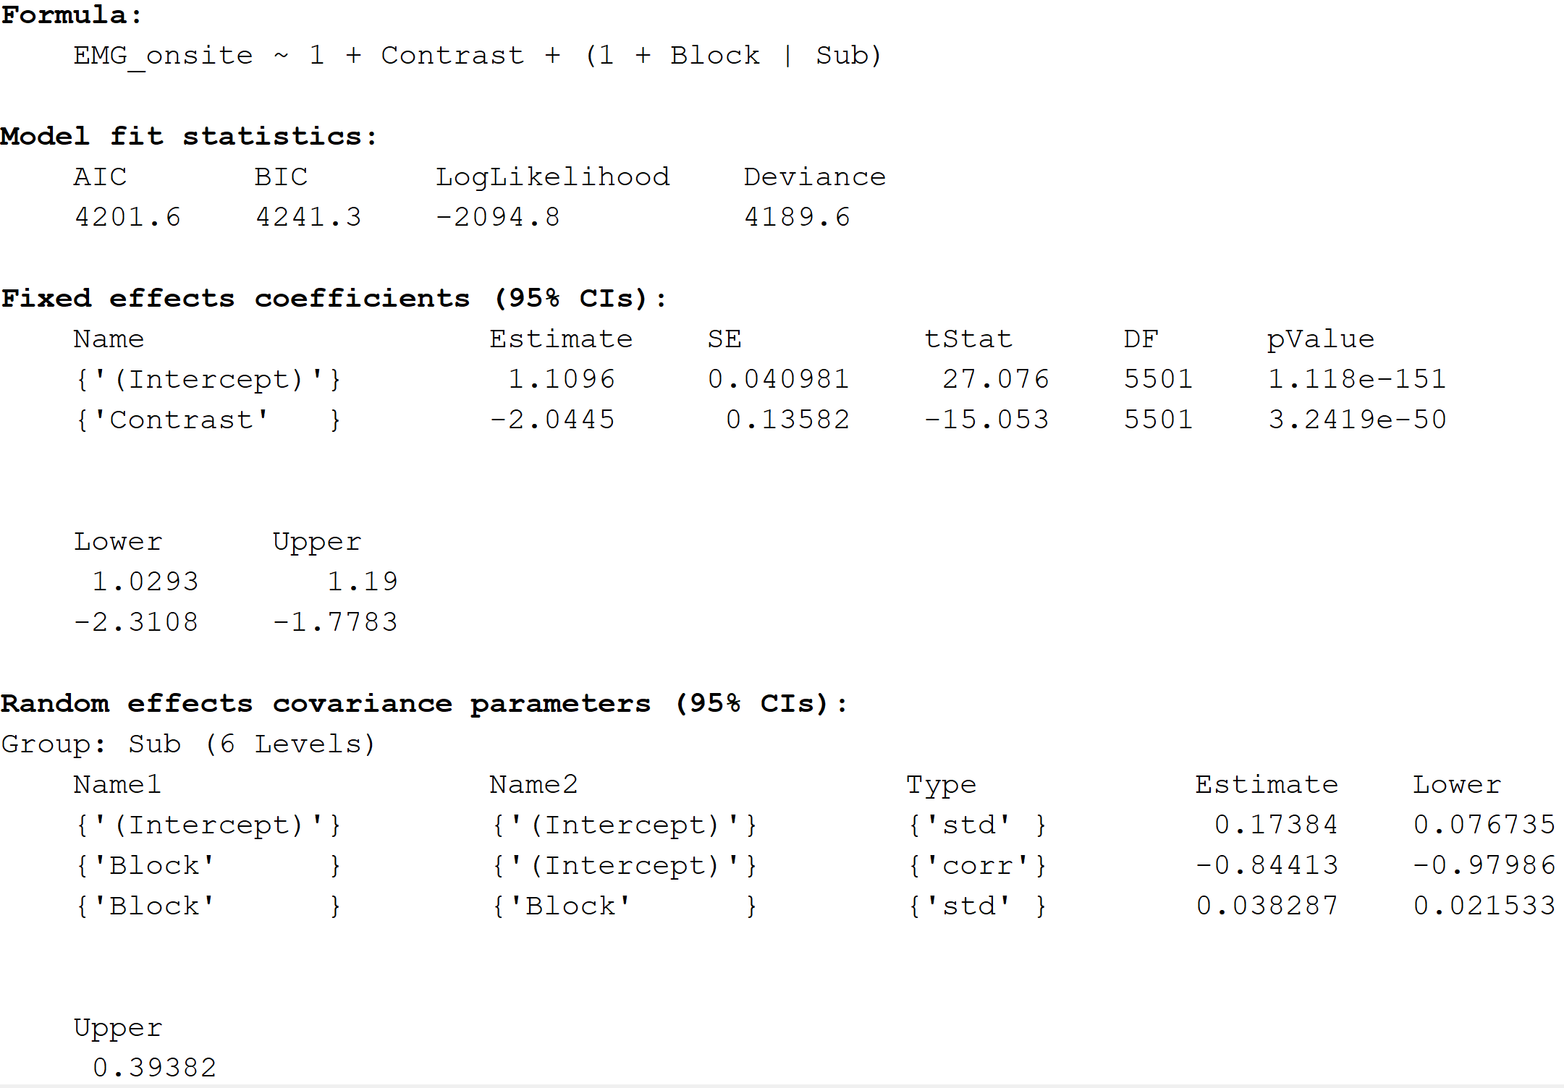
EMG_onsite VS Contrast ***

Slide 3
MT vs Muscle ***
Linear mixed-effects model fit by ML
Model information:
Number of observations 5503
Fixed effects coefficients 2
Random effects coefficients 12
Covariance parameters 4
Formula:
MT ~ 1 + Muscle + (1 + Block | Sub)
Model fit statistics:
AIC BIC LogLikelihood Deviance
-18561 -18522 9286.7 -18573
Fixed effects coefficients (95% CIs):
Name Estimate SE tStat DF pValue
{'(Intercept)'} 0.10857 0.0049235 22.052 5501 2.4659e-103
{'Muscle' } -0.00077183 3.0089e-05 -25.651 5501 3.5904e-137
Lower Upper
0.09892 0.11822
-0.00083082 -0.00071284
Random effects covariance parameters (95% CIs):
Group: Sub (6 Levels)
Name1 Name2 Type Estimate
{'(Intercept)'} {'(Intercept)'} {'std' } 0.013037
{'Block' } {'(Intercept)'} {'corr'} -0.43572
{'Block' } {'Block' } {'std' } 0.0026828
Lower Upper
0.0071425 0.023796
-0.86447 0.36003
0.0014731 0.0048858
Group: Error
Name Estimate Lower Upper
{'Res Std'} 0.044584 0.043758 0.045426

Slide 4
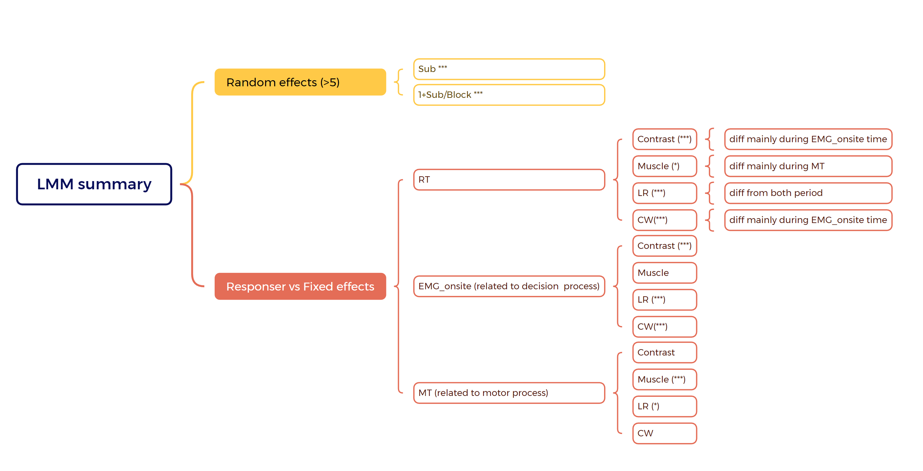

Slide 5


ICA move ahead (0.01 low pass?)
Annotate data
Filter data :
(0.1- 30 + 50*n Hz notch filter)
Epoch
(Stimulus-locked / response-locked )
Bad channels detection & interpolate (SD>50)
Re-reference the data to CAR
Interpolate bad channels on a trial-by-trial by TBT
Mark trials with eyeblinks & artefacts during pulses for rejection (AI)
CSD filtering
Time-frequency analysis
Fieldtrip
Beta power analysis: Morlet wavelet
DV calculation and
Fit Normative model
Group-average plotting

Slide 6
MB analysis update on EoL
Some people not have MB??
Mu + beta more clear

Slide 7
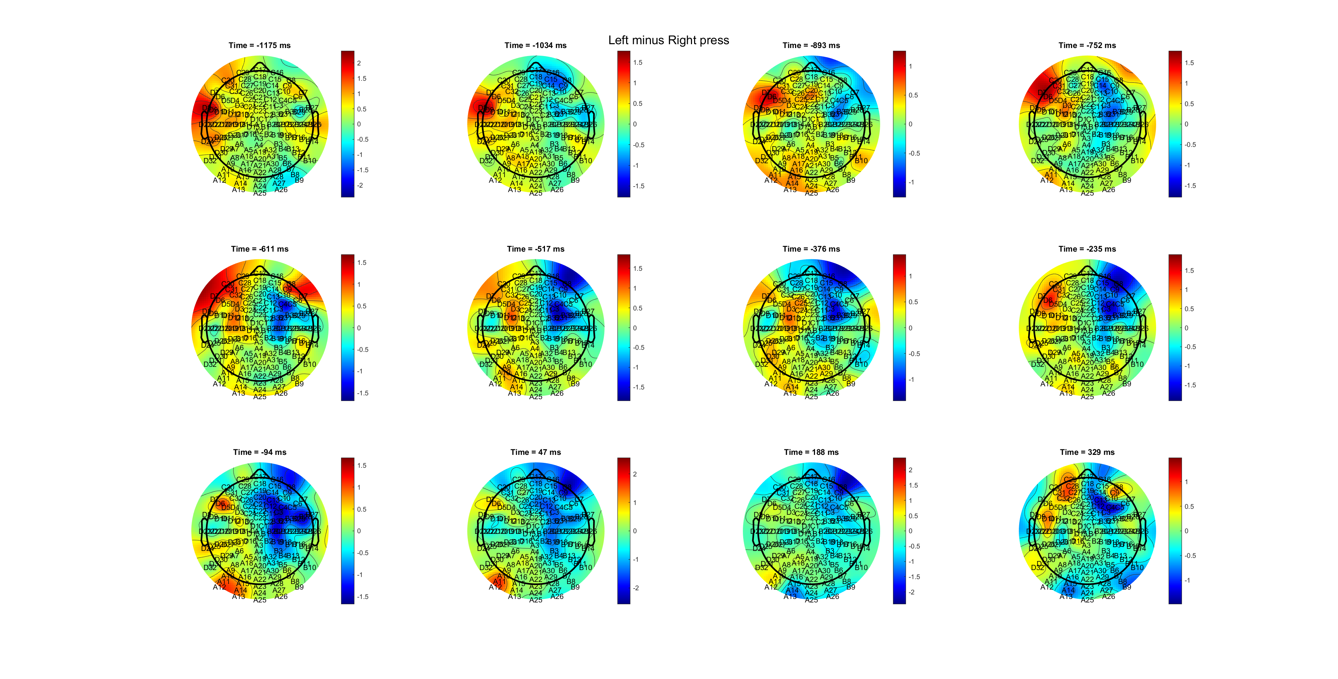
P6 (too front? Amplitude not around 6)

Slide 8
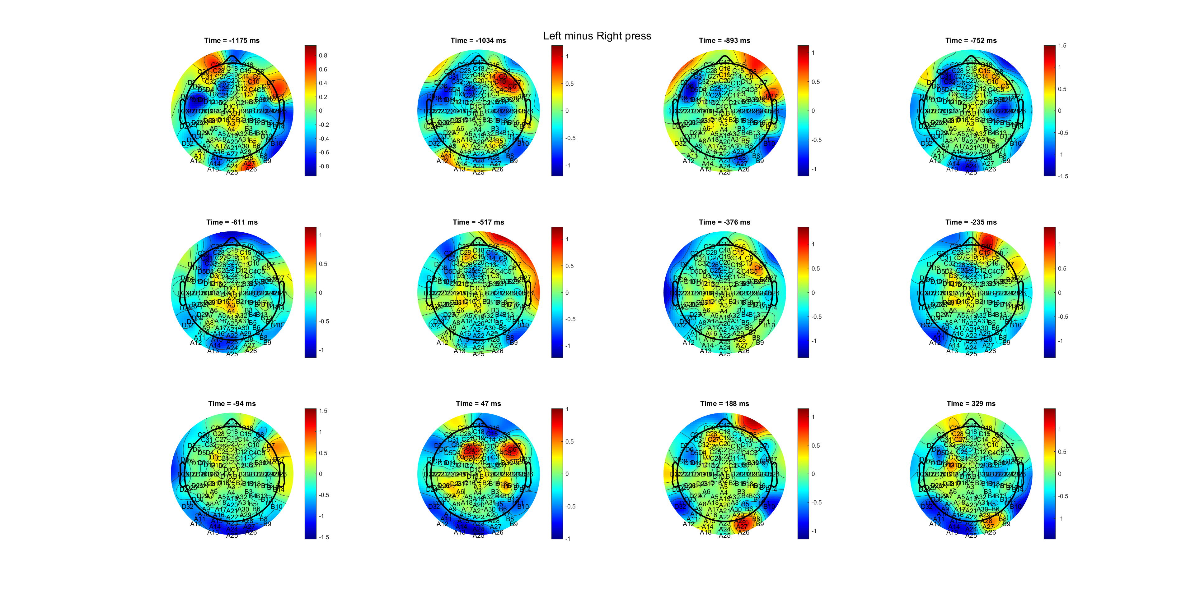
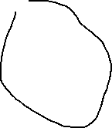
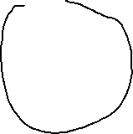
P2

Slide 9
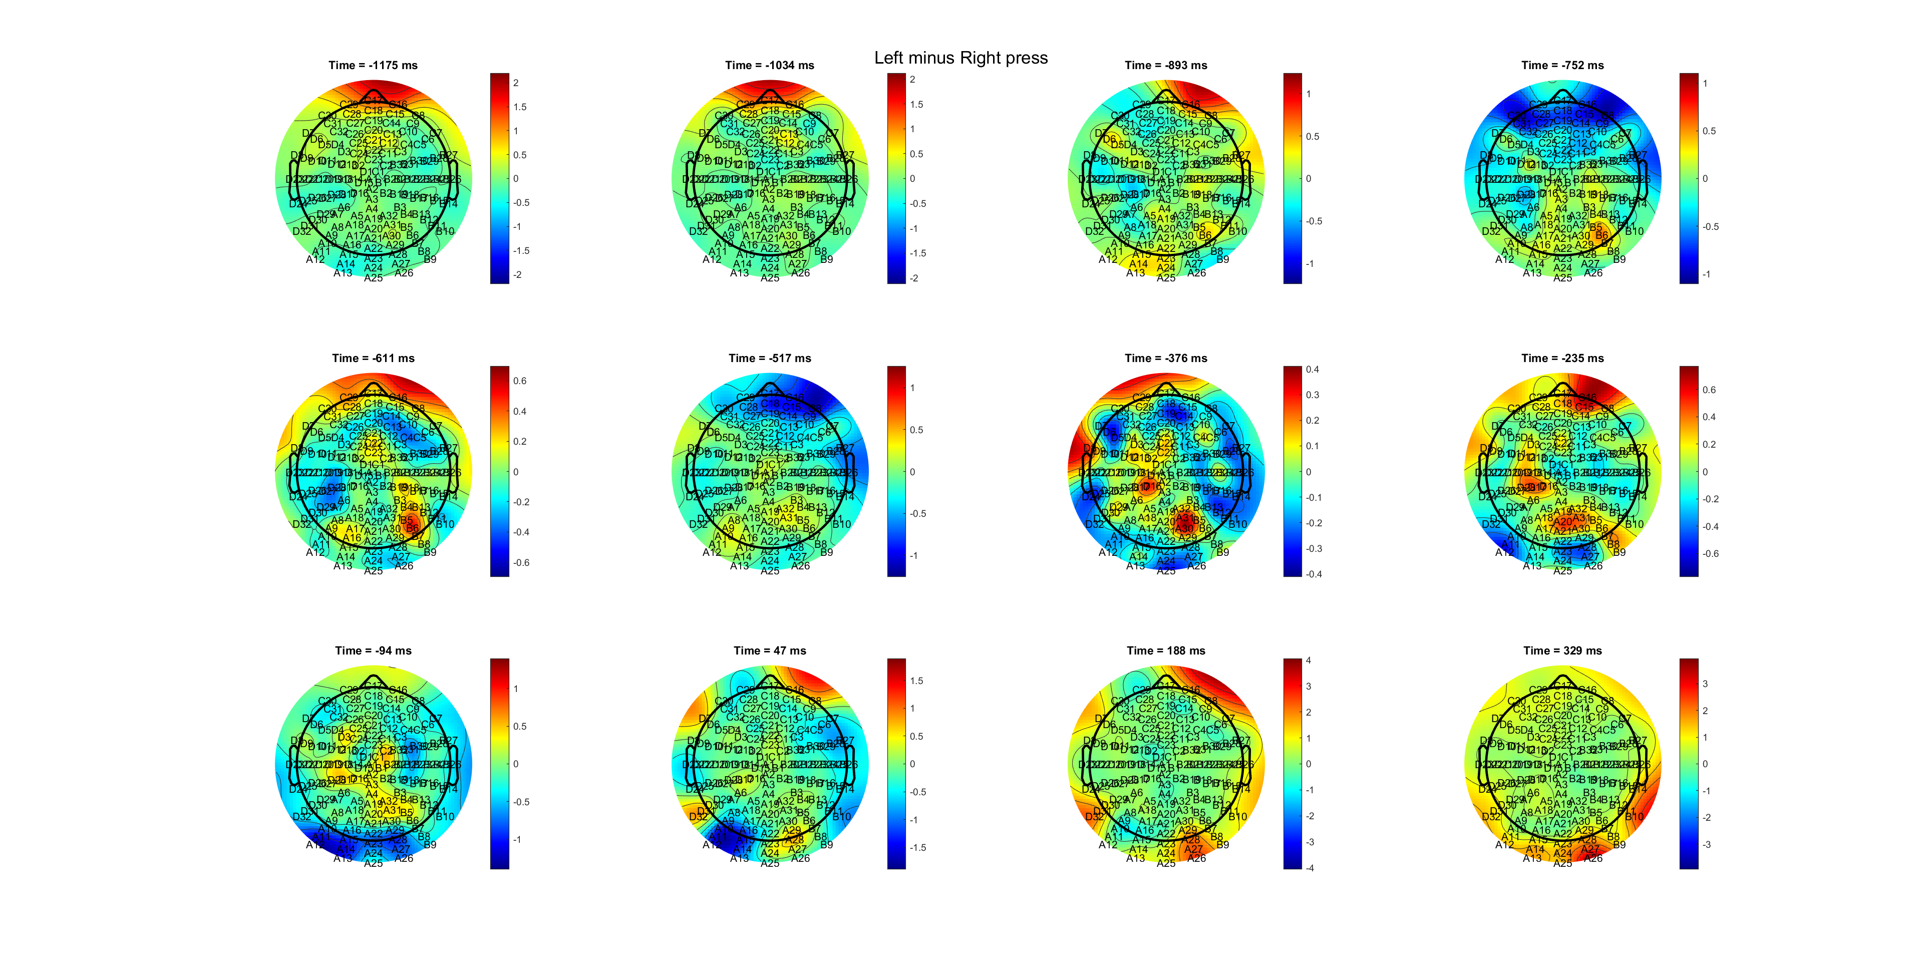
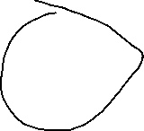
P4 (not observious)

